Slide 1
Unit 4
Lecture 3

Slide 2
Code Conversion
The availability of a large variety of codes for the same discrete elements of information results in the use of different codes by different digital systems.
It is sometimes necessary to use the output of one system as the input to another.
A conversion circuit must be inserted between the two systems if each uses different codes for the same information.
Thus, a code converter is a circuit that makes the two systems compatible even though each uses a different binary code.
To convert from binary code A to binary code B, code converter has input lines supplying the bit combination of elements as specified by code A and the output lines of the converter generating the corresponding bit combination of code B.
A Code converter (combinational circuit) performs this transformation by means of logic gates.
The design procedure of code converters will be illustrated by means of a specific example of conversion from the BCD to the excess-3 code.

Slide 3
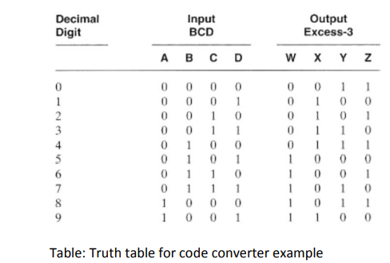
Design example: BCD to Excess-3 code converter

Slide 4
Decoders and Encoders
Decoder:
Discrete quantities of information are represented in digital systems with binary codes.
A binary code of n bits is capable of representing up to 2^n distinct elements of the coded information.
Decoder is a combinational circuit that converts binary information from (n) input lines to a maximum of 2^n unique output lines.
If the n-bit decoded information has unused or don't-care combinations, the decoder output will have fewer than 2^n outputs.
n-to-m-line decoders have m <= 2^n .

Slide 5
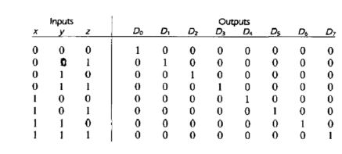
3 to 8 line Decoder:

Slide 6
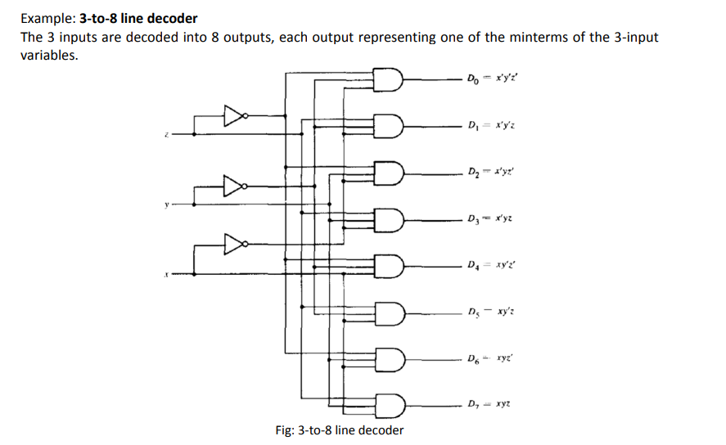

Slide 7
Encoder :
It is a digital circuit that performs the inverse operation of a decoder. An encoder has 2^n input lines and n output lines.
The output lines generate the binary code corresponding to the input value.
An example of an encoder is the octal-to-binary encoder which has eight inputs, one for each of the octal digits, and three outputs that generate the corresponding binary number.

Slide 8
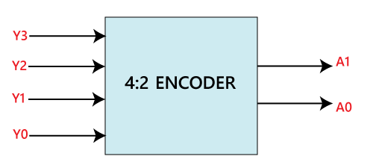
4 to 2 line Encoder:
In 4 to 2 line encoder, there are total of four inputs, i.e., Y₀, Y₁, Y₂, and Y₃, and two outputs, i.e., A₀ and A₁.
In 4-input lines, one input-line is set to true at a time to get the respective binary code in the output side.
Below are the block diagram and the truth table of the 4 to 2 line encoder.

Slide 9
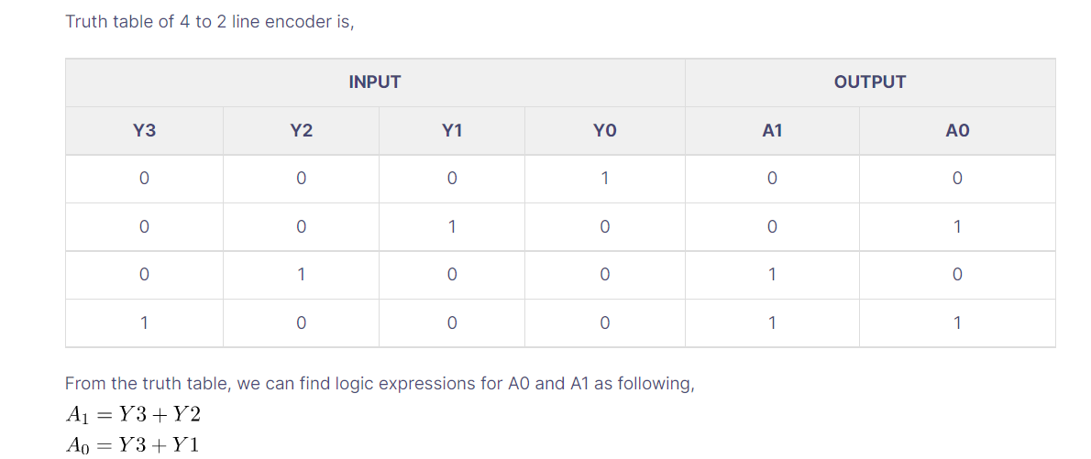

Slide 10
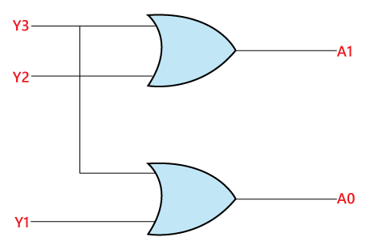
The logical expression of the term A0 and A1 is as follows:

Slide 11
8 to 3 line Encoder:
The 8 to 3 line Encoder is also known as Octal to Binary Encoder.
In 8 to 3 line encoder, there is a total of eight inputs, i.e., Y₀, Y₁, Y₂, Y₃, Y₄, Y₅, Y₆, and Y₇ and three outputs, i.e., A₀, A1, and A₂.
In 8-input lines, one input-line is set to true at a time to get the respective binary code in the output side.
Below are the block diagram and the truth table of the 8 to 3 line encoder.

Slide 12
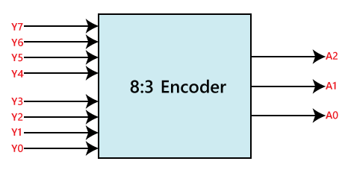
Block Diagram:

